Slide 1


Slide 2
INTRODUCTION
By analyzing Global Electronics' customer, product, sales, and store data, we aim to identify key insights that will enhance marketing strategies, optimize inventory management, and improve sales forecasting.
This will help tailor marketing campaigns, develop better products, plan effective promotions, and decide on store expansions and optimizations. Additionally, understanding the impact of currency exchange rates on sales will allow for better international pricing strategies.
Overall, these insights will help Global Electronics increase customer satisfaction and drive business growth.

Slide 3
PROBLEM STATEMENT
To conduct a comprehensive Exploratory Data Analysis (EDA) to uncover valuable insights from the company’s data.
The goal is to provide actionable recommendations that can enhance customer satisfaction, optimize operations, and drive overall business growth.
Datasets containing information about the customers, products, sales, stores, and currency exchange rates. The company, Global Electronics a leading retailer of consumer electronics seeks to leverage this data to better understand their business and identify areas for improvement.

Slide 4


Slide 5


Slide 6
CUSTOMER ANALYSIS
TOTAL CUSTOMERS AND SALES PERFORMANCE
15,256 customers contributing to $55.76M in sales with an average order value of $2,118.
INTERPRETATION
This indicates healthy revenue per customer.

Slide 7
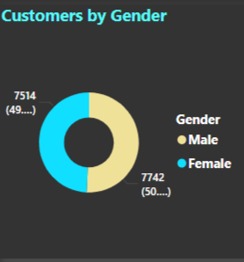
CUSTOMER DEMOGRAPHICS
GENDER DISTRIBUTION
INTERPRETATION
The customer base is split almost equally, with 49% female and 50% male customers with a count of 7514 and 7742.Marketing strategies were effective across genders.

Slide 8
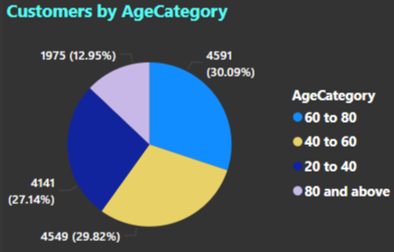
AGE CATEGORIES
INTERPRETATION
30.09% of customers fall into the 60 to 80 years age category ,with the count of 4591 is the largest segment.
The 40 to 60 years and 20 to 40 years groups also represent significant shares 29.82% and 27.14%, with the count of 4549 and 4141 respectively
The 80 and above category is 12.95% with a count of 1975 is the smallest segment.

Slide 9
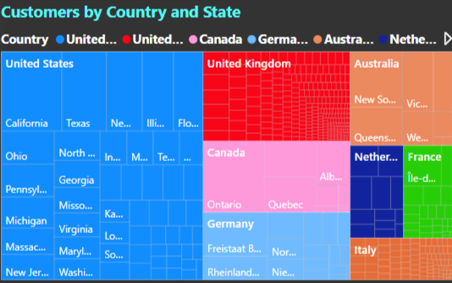
GEOGRAPHIC ANALYSIS
TOP STATES AND COUNTRIES
INTERPRETATION
The United States dominates sales, with states like California, Texas, and New York leading in customer counts. These locations are likely major hubs for electronics and retail activity. Consider state-specific promotions or partnerships in these states to strengthen the already strong customer base.
Significant contributions from United Kingdom, Germany, and Australia emphasize the potential of international markets. Countries with smaller but growing customer counts (e.g., Netherlands, Italy) may represent growth opportunities. Localized marketing in these areas can drive expansion.

Slide 10
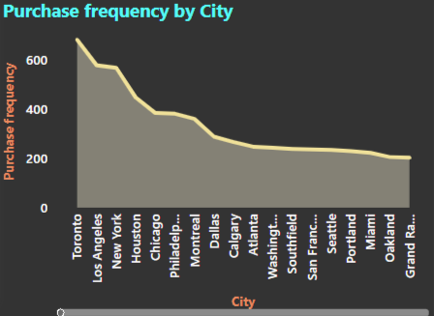
CITY-LEVEL ANALYSIS
INTERPRETATION
Cities like Toronto, Los Angeles, and New York have the highest and outperform others in purchase frequency. These cities are highly urbanized and tech-savvy and key markets, where customers likely have higher disposable incomes and access to products. Invest in localized advertising for these areas deserving focused promotional campaigns. Other cities show a declining trend, indicating potential untapped opportunities in mid-tier locations.

Slide 11
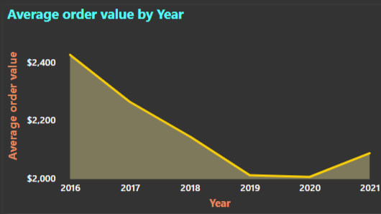
AVERAGE ORDER VALUE BY YEAR
INTERPRETATION
The line chart illustrates a steady decline in average order value from 2016 to 2021. Increasing competition is driving down prices, alongside shifts in customer preferences towards lower-cost items. There is a lack of consistent customer engagement strategies, such as upselling or premium offerings. This is a critical area to address—potentially through strategies like introducing premium products, upselling, or implementing loyalty or reward programs to incentivize larger purchases.

Slide 12
PURCHASE FREQUENCY
INTERPRETATION
Purchase frequency is highly concentrated in a few cities: Toronto, Los Angeles, and New York exhibit the highest engagement. Strengthen marketing efforts in these cities through targeted promotions and events. Cities with lower purchase frequencies may not be fully penetrated. For instance, cities like Sacramento or Grand Rapids are underperforming. Action: Investigate potential barriers (e.g., logistics, insufficient marketing presence) and devise strategies to boost engagement in these areas.

Slide 13


Slide 14
SALES ANALYSIS
TOP-LEVEL METRICS (KPIS)
Total Sales: $55.76M
Total Cost: $23.09M
Total Profit: $32.66M
Total Stores: 67
INTERPRETATION
The profit margin is ~58.58%, showcasing a highly profitable business model. Operating across 67 stores indicates a significant retail presence, possibly including both physical and online stores.

Slide 15
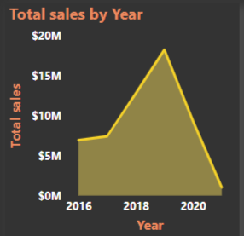
Sales Performance Over Time (Total Sales by Year)
INTERPRETATION
Peak Year 2019, with sales nearing $18.26M. Sales began low in 2016 and rose steadily until 2019, but there appears to be decline after 2019. The growth trend leading up to 2019 indicates effective strategies, likely linked to market demand, product launches, or marketing initiatives. Post-2019 decline could include factors like market saturation, economic conditions, or increased competition. Develop strategies to reignite growth.

Slide 16
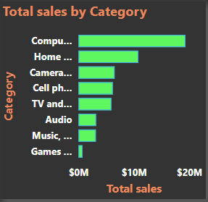
SALES BY CATEGORY
INTERPRETATION
Top-performing categories by revenue are computers and accessories $19.30M, home appliances $10.80M,cameras and camcorders: $ 6.52M,cell phones $6.18M. Lower-performing categories are music, movies, audio books and games are low-performing each below $4M. Computers and accessories lead in both revenue and volume, likely fueled by high demand for work-from-home or tech products. TV & video and music/games/audio underperform, indicating potential growth opportunities through targeted campaigns or pricing strategies.

Slide 17
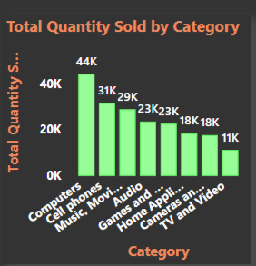
TOTAL QUANTITY SOLD BY CATEGORY
INTERPRETATION
Top-selling categories (by units) are Computers 44K units, Cellphones 31K units, Music, movies, audio books 29K units. Lower categories are cameras and camcorders 18K units and tv and videos 11K units. Computers dominate both revenue and units sold, affirming strong market demand. Home appliances show a low unit volume 18k sold, showing it is inversely propositional with total sales as it is in top performing categories with $10M sales. leverage the strong demand for computers and accessories to upsell related products or offer bundled packages

Slide 18
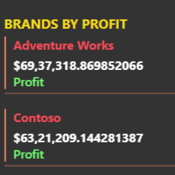
BRANDS BY PROFIT
INTERPRETATION
Top brands by profit are adventure works profit is $6.94M with profit margin 58.54% and Contoso $6.32M with profit margin 58.57%. Both brands contribute significantly to overall profitability, with adventure works leading slightly. These brands are the backbone of the company’s profitability and should remain a focal point for marketing and product expansion efforts. Low performing brands are A.Datum with profit $883K and northern traders with $649K.

Slide 19
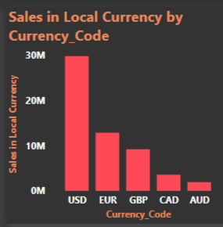
SALES IN LOCAL CURRENCY (BY CURRENCY CODE)
INTERPRETATION
USD dominates sales with revenue $29M followed by EUR with $11M and GBP with $7M. Other currencies cad, AUD contribute significantly less. The business is primarily focused on USD markets, likely the united states and countries dealing in USD. Develop localized strategies to grow sales in non-USD regions, such as Europe (EUR) and Australia (AUD).

Slide 20
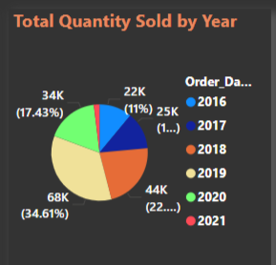
Total quantity sold by year
INTERPRETATION
Highest volume year 2019, with 68440 units sold. Other years show consistent sales, particularly 2018 with 44498 units and 2020 with 34463 units.
Sales peaked in 2019, likely boosted by external factors like covid-19 pandemic driving demand for tech and home appliances.Post-2019, sales volume has slightly declined, can be due to changing consumer preferences or operational challenges.

Slide 21
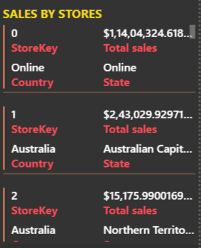
SALES BY STORES
INTERPRETATION
Online store generates the highest revenue $11.4M, significantly outperforming other stores. Followed by regional sales, such as Germany with $4.25M, stores in Canada with $3.61m.Regional sales in Australia, France show notable contributions but lag behind. The dominance of the online store indicates a strong shift toward e-commerce, which aligns with global retail trends. Invest in online infrastructure and marketing to further capitalize on this trend. Focus on underperforming physical stores for targeted improvements.

Slide 22


Slide 23
PRODUCT ANALYSIS
TOP-LEVEL METRICS (KPIs)
Total products: 2,517
Total cost: $23.09M
Total price: $55.76M
Profit: $32.66M
Profit margin: 58.58%
INTERPRETATION
The profit margin of 58.58% reflects a strong pricing strategy and efficient cost management. Managing a large catalog of 2,517 products indicates significant product diversity.

Slide 24
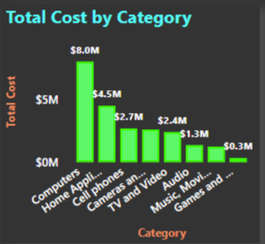
TOTAL COST BY CATEGORY
INTERPRETATION
Computers and Accessories $8M (highest cost category), Home Appliances $4.5M, Cell Phones and Accessories $2.7M. Computers and Accessories have the highest production or procurement costs, aligning with their revenue dominance. Lower-cost categories like Music/Games/Audio and TV & Video have costs under $2M, reflecting a smaller product line or lower unit costs.

Slide 25
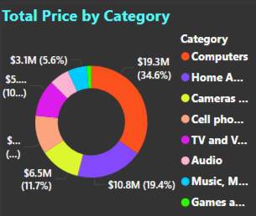
TOTAL PRICE BY CATEGORY (REVENUE)
INTERPRETATION
Computers and accessories $19.3m (34.6% of total revenue), home appliances $10.8m (19.4%), camera and camcorders $6.5m (11.7%). Computers and accessories dominate revenue, contributing over a third of total sales. Categories like music/games/audio and tv & video are relatively small contributors, with revenues of $3m and $5.9m, respectively. Focus on promoting underperforming categories or analyzing market demand for diversification opportunities.

Slide 26
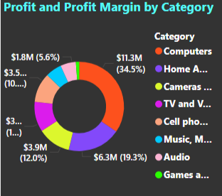
PROFIT AND PROFIT MARGIN BY CATEGORY
INTERPRETATION
Computers and accessories $11.3M profit (highest) with 34.5% share and 58.43% profit margin, Home Appliances 6.3M profit with 19.3% share and 58.32% profit margin, Music, Movies & Audio $1.91M with 5.85% share and 60.98% profit margin is lower with share percent but higher profit margins. Profitability aligns with revenue trends, with computers and accessories as the leader. Music, movies & audio have the low profit share and should be evaluated for pricing or cost-reduction opportunities.

Slide 27
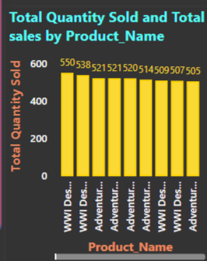
TOTAL QUANTITY SOLD BY PRODUCT NAME
INTERPRETATION
Top-selling products by quantity WWI desktops black 550 units, WWI desktops white 538 units, other top performers include adventure works monitors and adventure works printers, each selling over 500 units. The majority of sales come from high-demand products like WWI desktops and laptops, confirming strong consumer interest in tech-related items. Ensure inventory optimization for these top-selling products to meet demand and avoid stockouts.

Slide 28
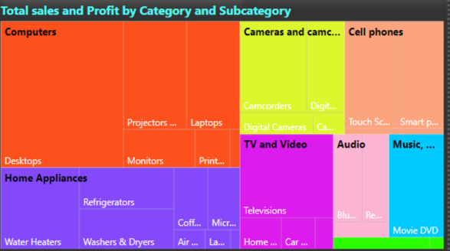
TOTAL SALES AND PROFIT BY CATEGORY AND SUBCATEGORY
INTERPRETATION
Top categories computers dominate, with significant contributions from desktops, monitors, and laptops, home appliances include strong subcategories like refrigerators and washers/dryers. Subcategories such as desktops and laptops make up the bulk of sales within computers and accessories, confirming their high consumer demand. Invest in marketing for smaller subcategories like TVs, monitors, and projectors to drive sales in underperforming areas.

Slide 29


Slide 30
STORE ANALYSIS
TOP-LEVEL METRICS (KPIS)
Total Sales: $55.76M
Sum of Square Meters: 92,545 sqm
Profit: $32.66M
Sales Per Square Meter: $602.47
Profit Margin: 58.58%
INTERPRETATION
With a overall profit margin of 58.58%, stores are performing exceptionally well in terms of cost efficiency and pricing strategy. The sales per square meter $602.47 indicate good utilization of available retail space across stores. To be noticed overall profits and profit margins may look well, post-2019 sales drastically decreased.

Slide 31
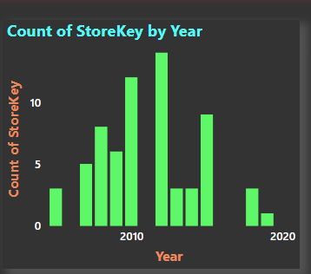
COUNT OF STORES OPENED BY YEAR
INTERPRETATION
The total number of stores is 67. The highest number of openings occurred in 2010, with a count of 12, and in 2012, with a total of 14. Openings in other years, such as 2008 with 8 stores opened and 2020 with 9 stores opened, are relatively moderate. Store expansion strategies were particularly aggressive in certain years, especially 2005 and 2015. The fewer store openings in 2020 may be attributed to market saturation or external challenges like the impact of COVID-19.

Slide 32
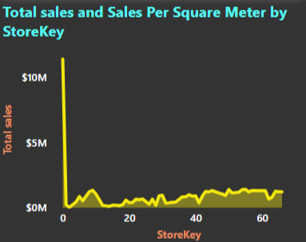
SALES BY STORE KEY
INTERPRETATION
Store key 0 is the online store. Store keys between 1 and 20 are located in germany, Canada, and France, in which the sales peaked in store key 9, located in Canada and opened in 2005 with $1.34m. Store keys between 20 and 40 are located in the united kingdom, Netherlands, germany, and Italy, in which the sales peaked in store key 38 located in the united kingdom and opened in 2015 at $1M. Store keys between 40 and 66 are located in the united states and the united kingdom, in which the sales peaked in store key 55 located in the united states and opened in 2009 at $1.42m.A few stores contribute significantly to total sales, indicating possible disparities in location performance or store management. Optimization should be done for underperforming and underutilized locations.

Slide 33
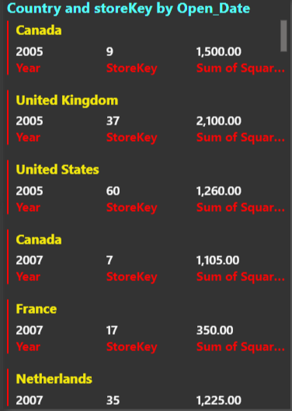
COUNTRY AND STORE COUNT
INTERPRETATION
Top performers are as follows: The United States leads with the highest sales of $23.76M and the most stores at 24, demonstrating excellent efficiency of $625.5/sqm. The United Kingdom follows with $5.75M from 7 stores and a good efficiency of $456.3/sqm. The online store generates $11.40M, outperforming most physical locations. The United States and France have the highest sales per square meter at $625.5 and $514.6, respectively, indicating efficient store performance. Germany has the largest store area at 12,750 sq ft but a moderate efficiency of $333.3/sqm. Opportunities for improvement exist in regions like Australia and the Netherlands, which show lower efficiencies of $226.9 and $259.5/sqm. Focusing on optimizing these department store areas could involve downsizing or better utilization to enhance efficiency. For regional expansion, target high-efficiency regions like Canada, France, and Italy for new stores or focused marketing.

Slide 34


Slide 35
FINDINGS AND SUGGESTIONS
Geographic expansion while focusing on key regions like California, and exploring under-performing areas with growth potential, such as Michigan or Virginia. Leverage city-level insights to develop localized campaigns for mid-tier cities like Sacramento or Grand Rapids.
Engage younger audiences by targeting the 20–40 year old demographic with tech-oriented promotions or budget-friendly offers, as this group represents a significant portion of customers and may have untapped potential for increased spending.
Boost AOV with premium offerings develop premium product tiers to appeal to older demographics with higher disposable incomes. Bundle complementary products to encourage larger purchases.
Personalized marketing segments customers by age, gender, and location to create personalized offers, emails, and promotions.
International focus enhances marketing efforts in regions such as Australia and Germany, where customer bases are substantial yet have potential for growth..

Slide 36
Customer retention strategies tackle AOV decline by implementing loyalty programs and cross-selling opportunities. Provide exclusive discounts to returning customers, particularly in high-value age groups such as 60–80 years.
Reignite post-2019 sales growth by exploring promotions, new product lines, or partnerships to drive growth.
Concentrate on computers, accessories, and home appliances, as they lead in both sales and volume. Implement targeted campaigns to boost underperforming categories such as TV and video.
Enhance non-USD market presence by strengthening marketing and operational efforts in the EUR and AUD regions to increase international sales.
Enhance the online store experience by leveraging its dominance through improved user experience, the introduction of loyalty programs, and the offering of exclusive online deals.
Diversify Product Portfolio Reduce dependence on a limited number of high-performing products by introducing new products or variants
Store-Specific Strategies Concentrate on underperforming regions and physical stores to enhance operations and sales.
Leverage Dominant Categories, focus on expanding Computers and Accessories, as well as Home Appliances, since they dominate both revenue and profit.

Slide 37
Focus on high-performing stores. Invest in and replicate strategies from stores with high sales performance, such as store keys 9, 38, and 55.
Address under performing categories such as target tv & video and music, movies & audio through marketing campaigns, bundling strategies, or price adjustments to enhance sales.
Optimize inventory for top products, maintain adequate stock levels for high-selling products like WWI desktops and laptops to meet demand and avoid revenue loss.
Expand customer interest and sales by diversifying subcategories and promoting underrepresented ones, such as projectors and audio equipment.
Prioritize high-performing stores by investing in and replicating successful strategies from top-performing locations, such as stores with keys 9, 38, and 55.
Improve underperforming locations by analyzing stores with low sales per square meter and implementing corrective measures, such as enhancing store layouts, optimizing stock management, or boosting promotions.
Capitalize on high-sales regions by enhancing marketing efforts and product availability in areas like the united states and the united kingdom, which lead in store count and sales.
Analyze the decline in sales since 2019 and develop strategies to restore growth and regain momentum.

Slide 38
CONCLUSION
By leveraging these insights and strategies, Global Electronics can enhance operational efficiency, improve customer engagement, optimize product offerings, and achieve sustainable growth, solidifying its position in the competitive electronics retail market.

Slide 39



